Slide 1







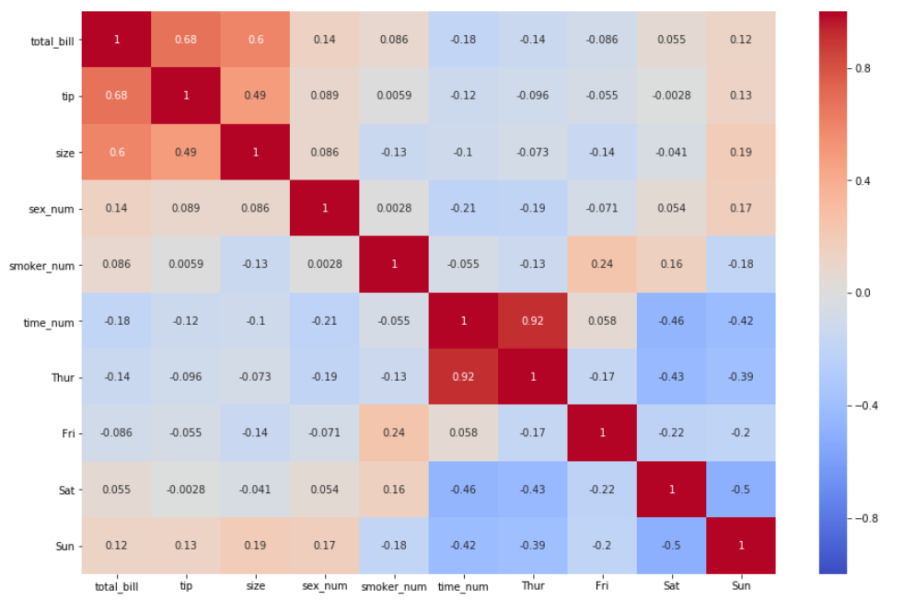



Cloudy With a Chance of Football (Cohort 23): Capstone Project Data Architecture
Data Ingestion
Data Limits
Years: 2019 and 2020
Positions: All offensive positions
Platform: ESPN
Columnst
Column Name | Data Type | Unique Variables or Description
player_id | integer
unique_id | string | firstnamelastname
player_name | string | Firstname Lastname
year | integer | 2019 2020
week | integer
week_start | datetime | YYYY-MM-DD
week_id | string | YYYY_WW
position | string | qb, rb, te, wr, k
age | float
dob | datetime | YYYY-MM-DD
time_zone | integer | Hours away from Greenwich mean time of home time zone
team_name | string | Official team abbreviation codes
injury_status | integer | 0 : no injury 1 : questionable 2 : out
days_since_last_game | integer
hours_displaced | integer | Number of hours away from home time zone
temperature_min | integer
temperature_max | integer
precipitation | float
PassingYds | float
PassingTD | integer
Int | integer
PassingAtt | integer
Cmp | integer
RushingAtt | integer
RushingYds | float
RushingTD | integer
Rec | integer
Tgt | integer
ReceivingYds | float
ReceivingTD | integer
FL | integer
location | integer | 0 : away 1 : home
predicted | float | ESPN prediction for player fantasy points
actual | float | Actual number of ESPN fantasy points achieved
performance | integer | 0 : predicted < actual 1 : actual < predicted
Munging and Wrangling
players
player_id | unique_id | player_name
0 | tombrady | Tom Brady
1 | joshallen | Josh Allen
week_table
year | week | week_start | week_id
2019 | 1 | 20190907 | 2019_1
2019 | 2 | 20190914 | 2019_2
positions
player_id | position
0 | qb
1 | qb
team_home_time_zone
team_name | week_id | time_zone
NE | 2019_1 | -5
BUF | 2019_1 | -5
NFL Savant
Individual player data
2019 play-by-play data
2020 play-by-play data
player_age
player_id | week_id | age
0 | 2019_1 | 42.1
1 | 2019_1 | 25.52
nflsavant_ingestor.py
nflsavant_cleaner_eda.ipynb
nflsavant.csv
player_dob
player_id | dob
0 | 19770803
1 | 19960521
player_team
player_id | week_id | team_name
0 | 2019_1 | NE
1 | 2019_1 | BUF
game_location
week_id | team_name | location
2019_1 | NE | 1
2019_1 | BUF | 0
Fantasy Football Data Pros
Weekly fantasy stats
2019 ESPN projection data
datapros.csv
datapros_ingestor.py
datapros_cleaner_eda.ipynb
injury_status
player_id | week_id | injury_status
0 | 2019_1 | 0
1 | 2019_1 | 0
days_since_last_game
team_name | week_id | days_since_last_game
NE | 2019_2 | 6
BUF | 2019_2 | 5
time_displacement_table
week_id | team_name | hours_displaced
2019_1 | NE | 0
2019_2 | BUF | 0
performance
player_id | week | predicted | actual | performance
0 | 2019_1 | 18.20 | 21.90 | 1
1 | 2019_1 | 29.35 | 27.10 | 0
0 | 2019_2 | 25.87 | 18.50 | 1
1 | 2019_2 | 19.93 | 28.98 | 1
Kaggle Data
2019 stats and 2020 projections
kaggle.csv
weather
week_id | team_name | temperature_min | temperature_max | precipitation
2019_1 | NE | 58 | 75 | .1
2019_1 | BUF | 35 | 48 | 3
kaggle_ingestor.py
kaggle_cleaner_eda.ipynb
opponents table
week_id | team_name | game_date | ARI | ATL | BAL | BUF | CAR | CHI | CIN | CLE | … | NE | NO | NYG | NYJ | PHI | PIT | SF | SEA | TB | TEN | WAS
2019_1 | NE | 20190907 | 0 | 0 | 0 | 0 | 0 | 0 | 0 | 0 | … | 0 | 0 | 0 | 0 | 0 | 1 | 0 | 0 | 0 | 0 | 0
2019_2 | BUF | 20190906 | 0 | 0 | 0 | 0 | 0 | 0 | 0 | 0 | … | 0 | 0 | 0 | 1 | 0 | 0 | 0 | 0 | 0 | 0 | 0
Carnegie Mellon
Temperature and precipitation data
cmu.csv
stats_table
player_id | week_id | PassingYds | PassingTD | Int | PassingAtt | Cmp | RushingAtt | RushingYds | RushingTD | Rec | Tgt | ReceivingYds | ReceivingTD | FL
0 | 2019_1 | 324 | 5 | 0 | 20 | 17 | 3 | 6 | 0 | 0 | 0 | 0 | 0 | 0
1 | 2019_1 | 405 | 4 | 0 | 32 | 25 | 4 | 12 | 0 | 0 | 0 | 0 | 0 | 0
cmu_ingestor.py
cmu_cleaner_eda.ipynb
Machine Learning
Computation and Analysis
Determine best features for model selection using, among other things, a correlation matrix
Normalize all data from 0 to 1
Convert string data to integer data
Check on class imbalance
Divide into a train (80%) test (20%) split of data
Model 6: Kickers
Model 5: Wide Receivers
Model 4: Tight Ends
Model 3: Running Backs
Model 2: Quarterbacks
Model 1: All players
Reporting and Visualization
Develop a simple web application using either Django or Flask
model6.ipynb
model5.ipynb
model4.ipynb
model3.ipynb
model2.ipynb
model1.ipynb
 | Train
 | Test

